Slide 1
BULK FILE DOWNLOADER

Slide 2
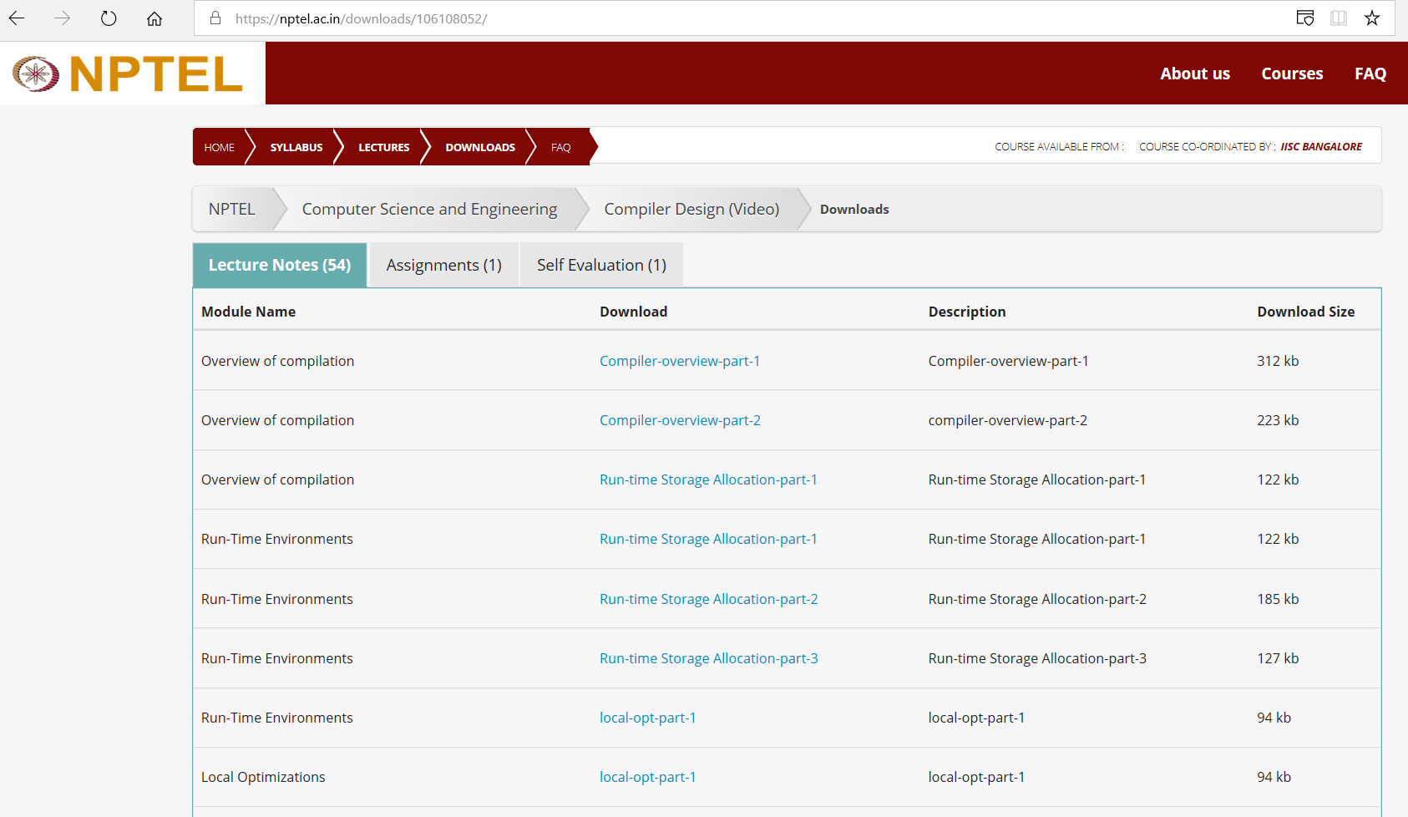
What?
Why?
Used to Download the files in whole Bulk
Suppose we need to download the all the files of the given URL.
So, it would be a tedious task to download all the files one by one from it
And also harmful if we miss any single file.

Slide 3
How?
We can do it by using wget command
Wget is a linux shell command used to download all the files from the given URL via terminal
eg: $wget <url> //This will download the files of particular URL
$wget –r <URL> //This will download all the files and from subdomain of that url
-r means it would do recursively search for all its subdomains to download everything

Slide 4
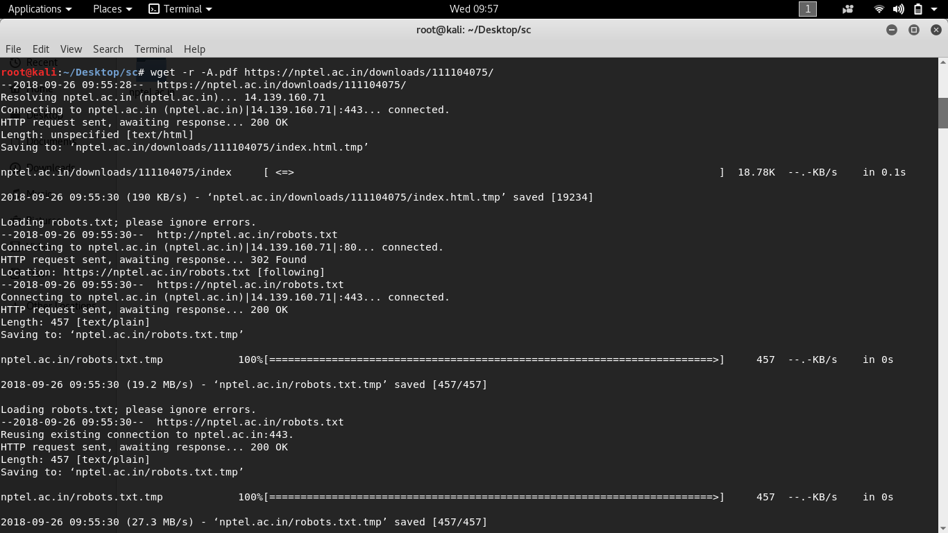

Slide 5
How We Can Automate This ?

Slide 6
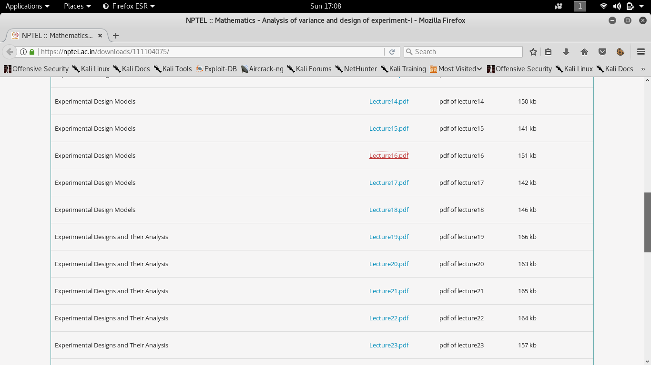

Slide 7
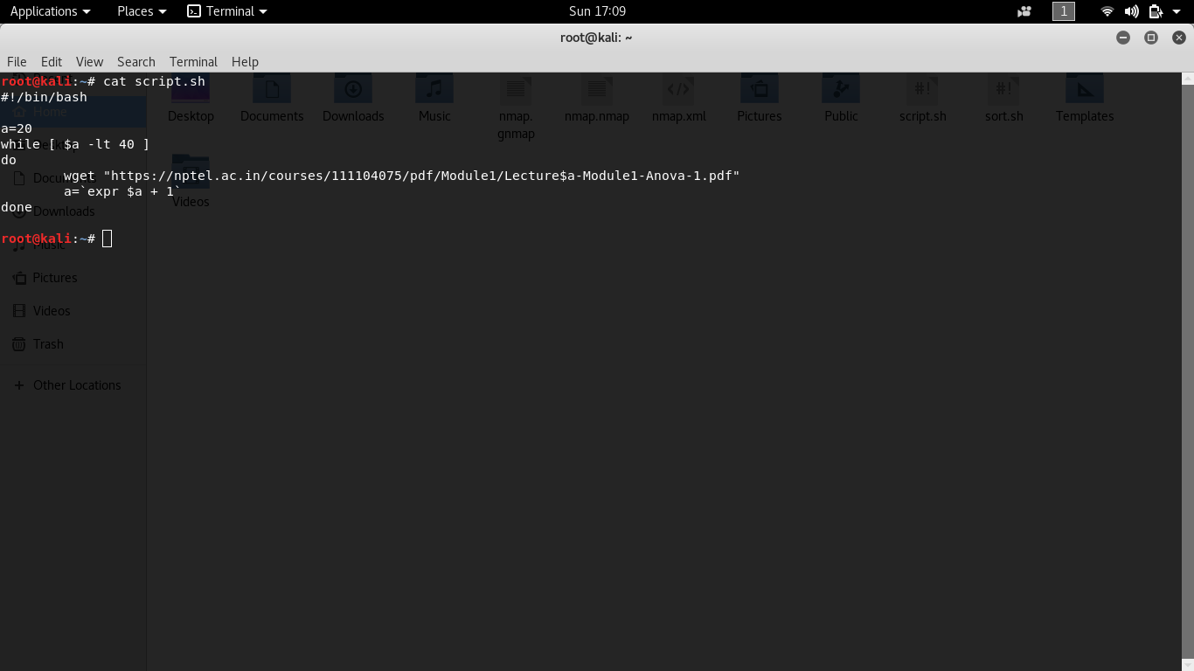
Hence we can automate the downloading process using the shells script
#!/bin/bash
a=20
while [ $a -lt 40 ]
do
wget "https://nptel.ac.in/courses/111104075/pdf/Module1/Lecture$a-Module1-Anova-1.pdf"
a=`expr $a + 1`
done

Slide 8
Install LAMP STACK
LAMP STACK is couple of softwares capable of running a fledged application in their own.
1. Apache // is web server that handles http connections via web browser.
2. Mysql // it is a database server used to store, retrieve and query data.
3. Php // it is a general purpose programming language used for web development

Slide 9
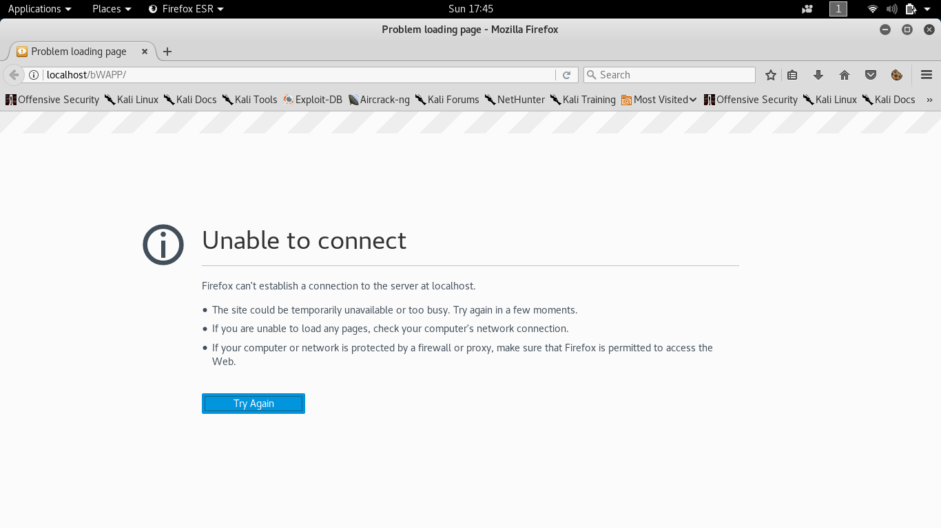

Slide 10
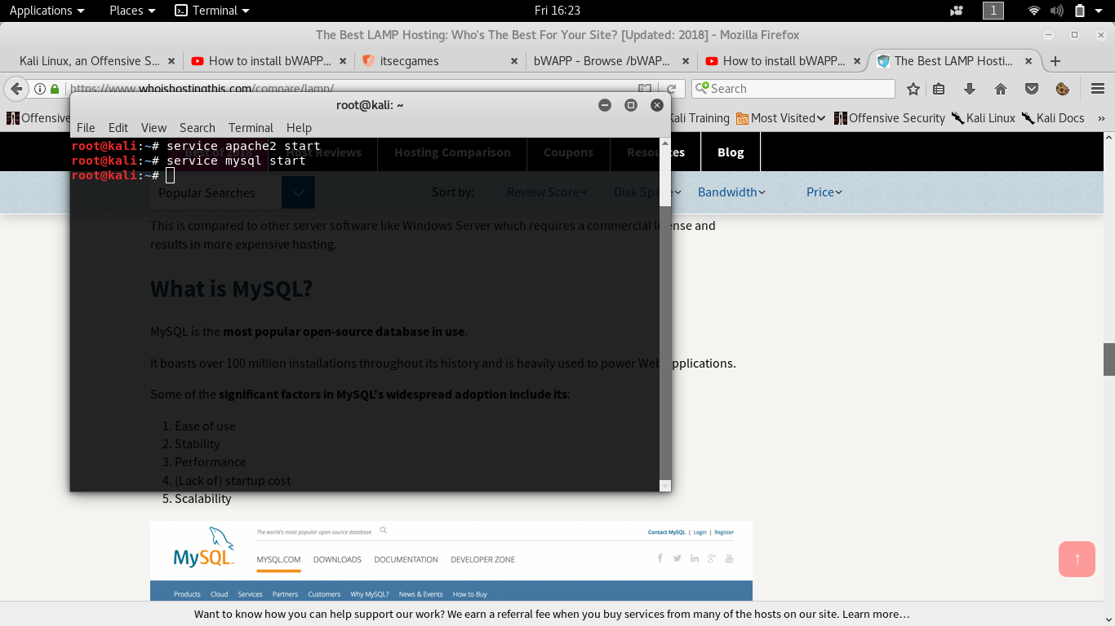

Slide 11
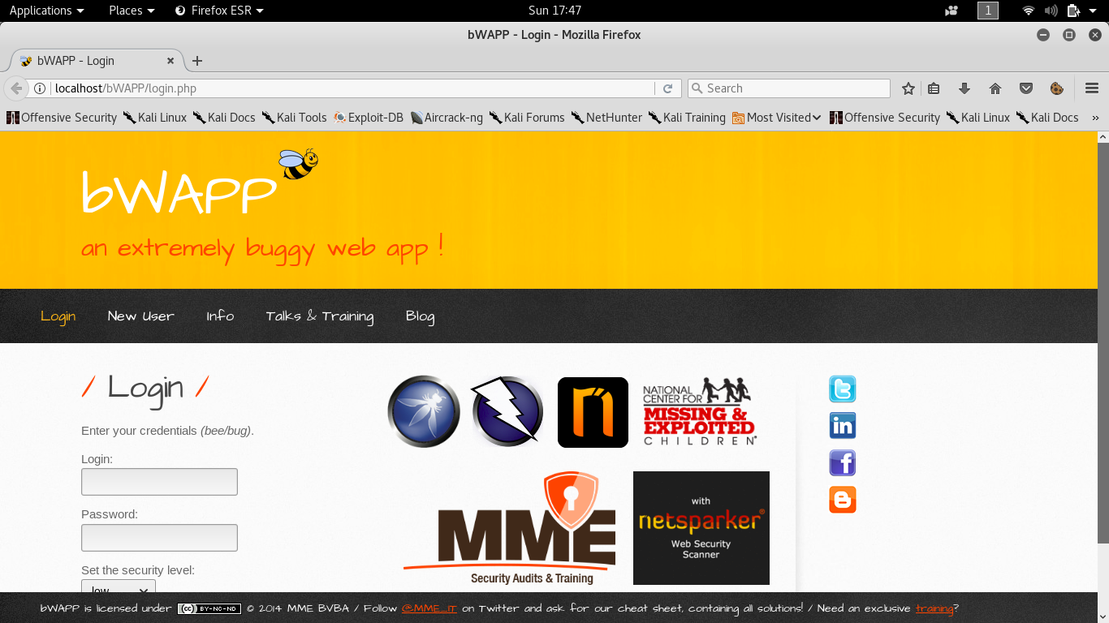

Slide 12
How to find public and private IP
Private IP
Public IP
Private IP is an Ip that is used within a local network (Intranent)
It can be found by typing command $ifconfig in terminal
A Public IP address is provided to us by router which is publicly accessible to internet.

Slide 13
How to find the Public IP and Private IP

Slide 14
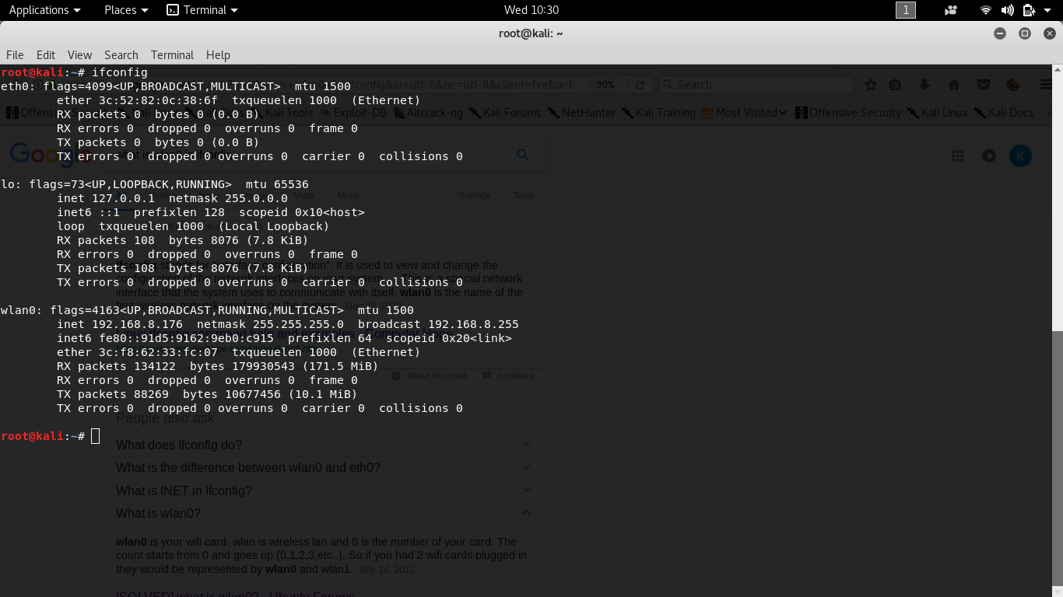

Slide 15
Command to find our public or external IP
$ sudo curl ipecho.net/plain; echo

Slide 16
https://nptel.ac.in/downloads/111104075/

